Slide 1
WEB3.0 SMART INTERIOR DESIGN
HELIX++

Slide 2
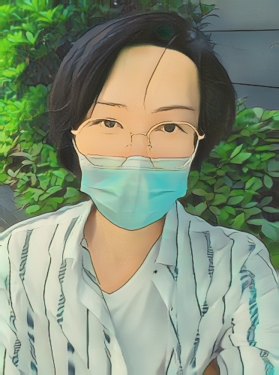
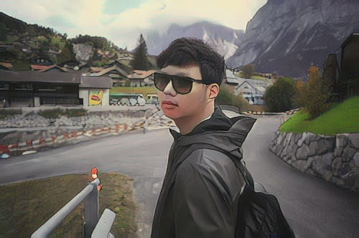
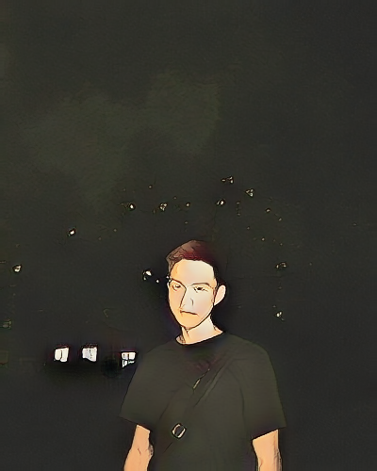
Members
YEXING LI
Computer Vision Engineer
CHENCHEN TANG
Game Developer
YUZHANG JIANG
Cryptography Engineer

Slide 3
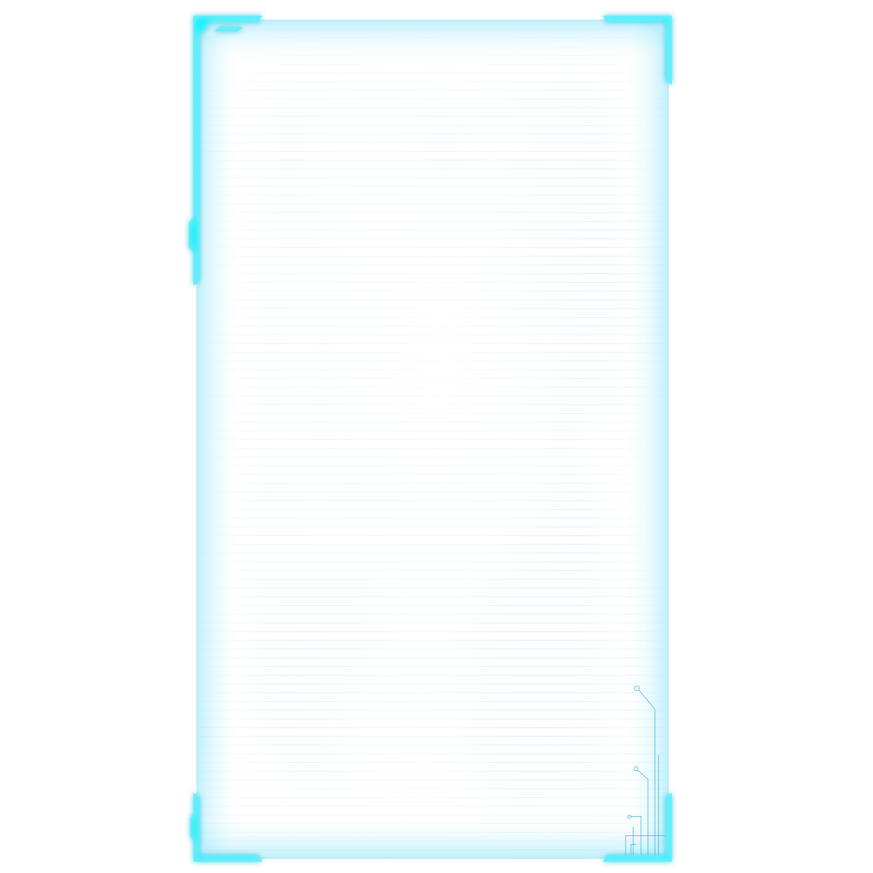
Problems
Creation copyright protection issues in the interior design industry
Restricted secondary creation in the interior design industry

Slide 4
Solutions
Use blockchain technology to reasonably record the creation and transformation process of works.
Support the whole process of viewing the works. It can track the source of all multiple creations with one click.
Provide secondary creation ability based on the works of others.
Give full play to copyright protection capabilities, enrich creative space, and accelerate industry exchanges.

Slide 5
Features
IPFS
Venachain
Unreal Engine
Artificial Intelligence

Slide 6
Process
0 1
0 3
NFT
Release
0 2
0 4
Creation
Transaction

Slide 7
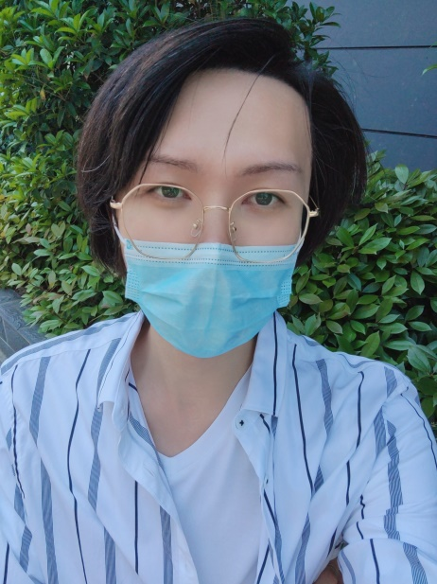
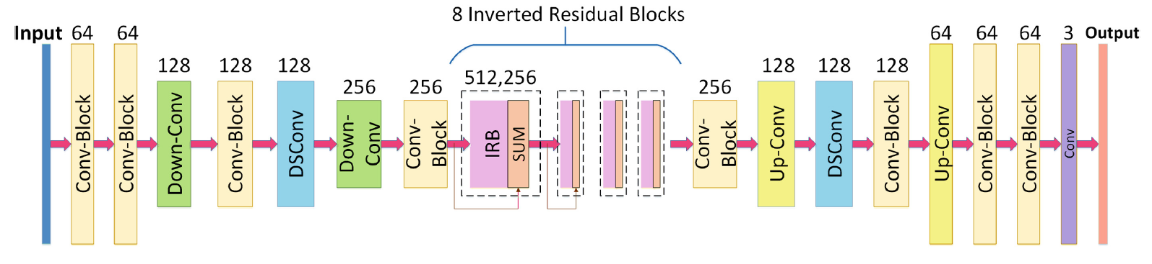
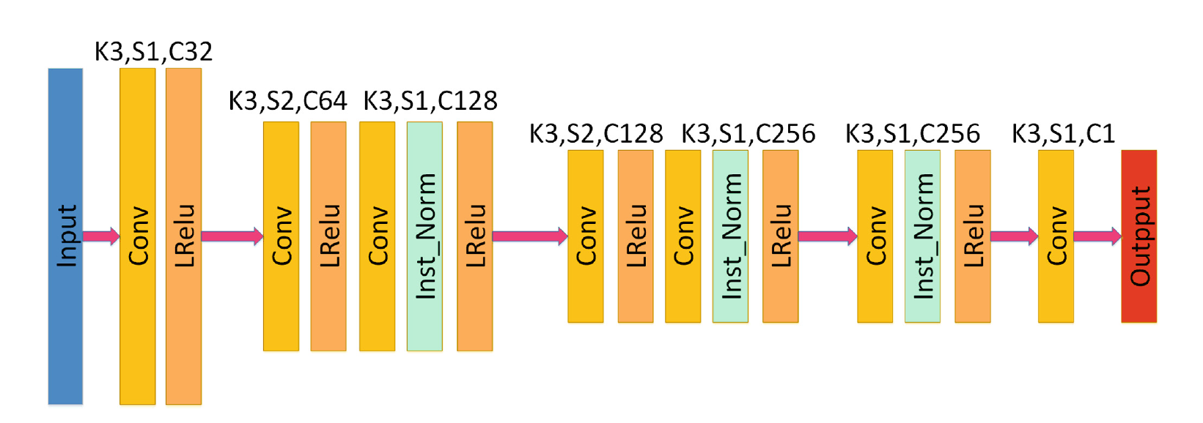
ACG NFT

Slide 8
Style Transfer
Have you ever imagined seeing the world through the eyes of Vincent van Gogh, Pablo Picasso or Wassily Kandinsky - a world full of strokes and brushes?
Style transfer is a computer vision technique that allows us to compose the content of an image in the style of another image.
At the beginning of Metaverse, there are few materials, while the traditional method requires users to construct manually. Our method allows users to customize the generation of furniture, floors, walls, etc. of various materials.

Slide 9
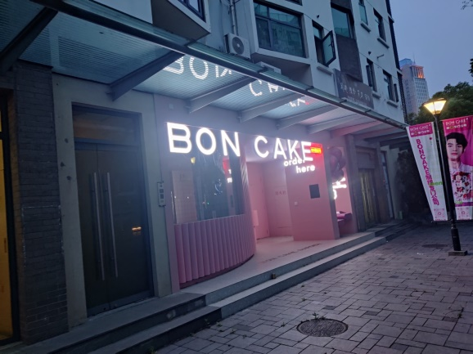
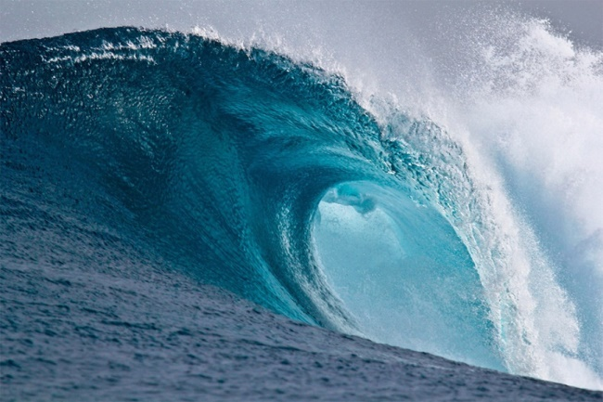
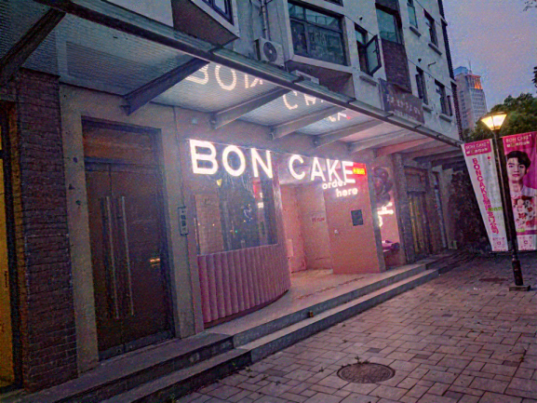
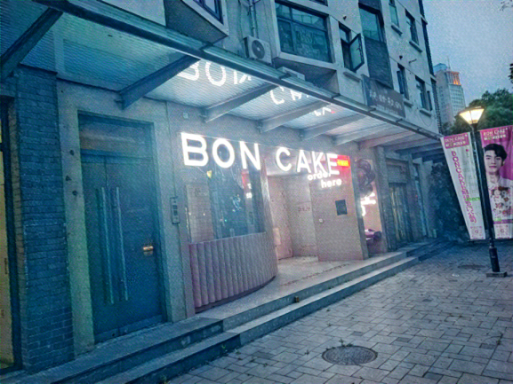
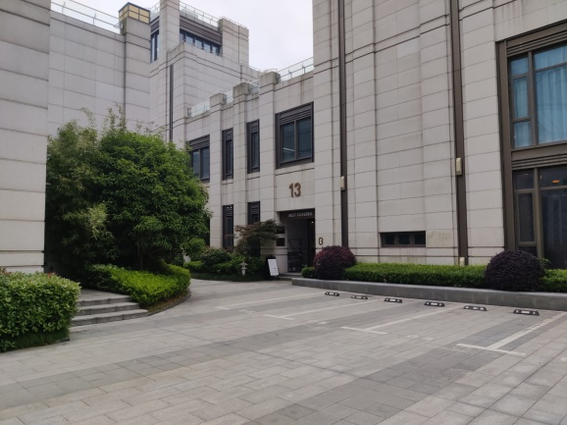
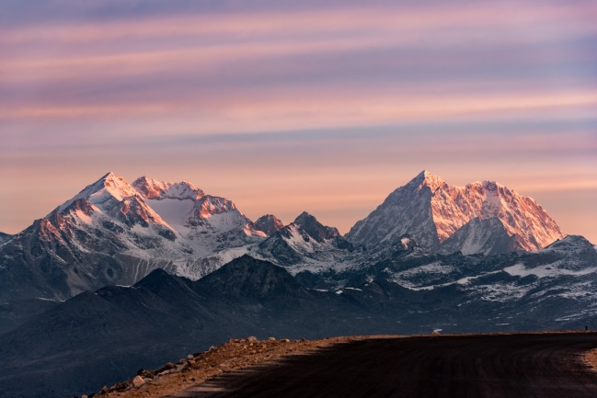
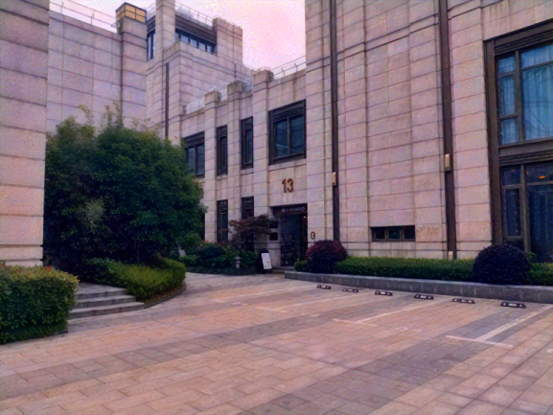
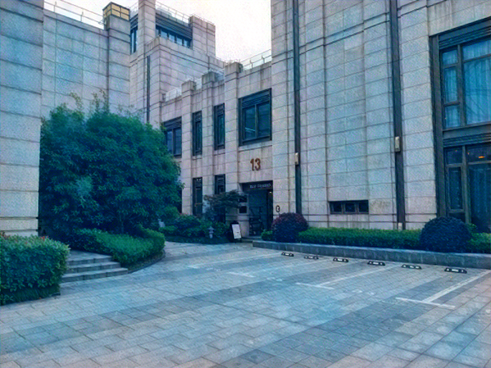
Filters

Slide 10
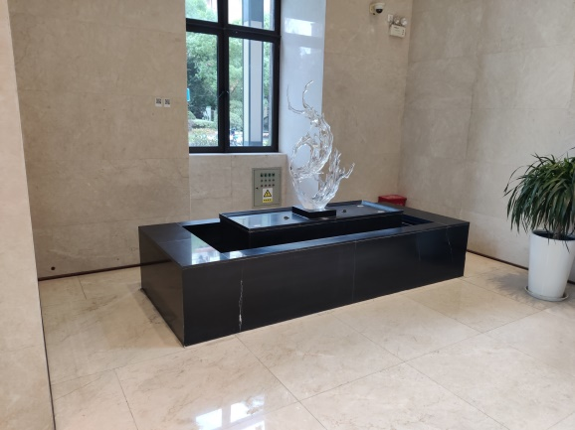
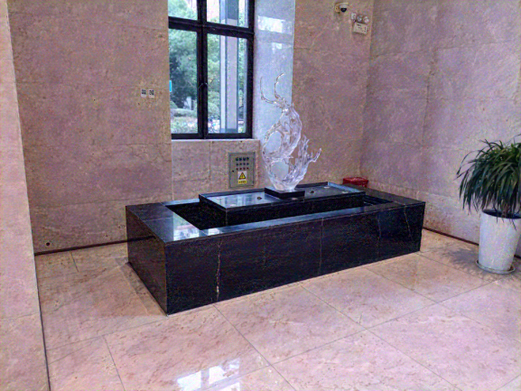
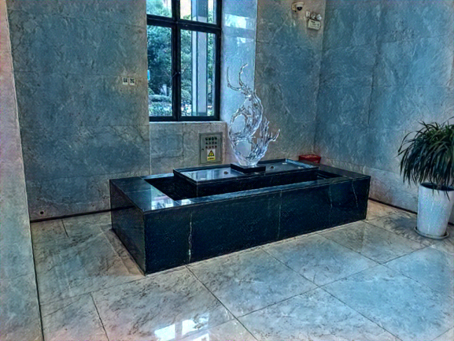
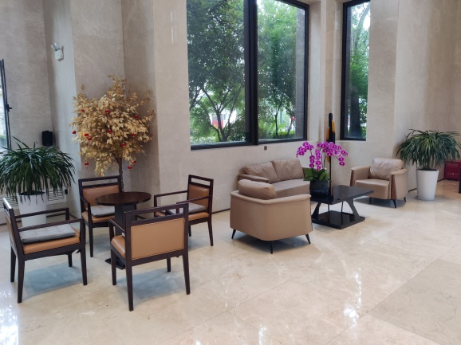
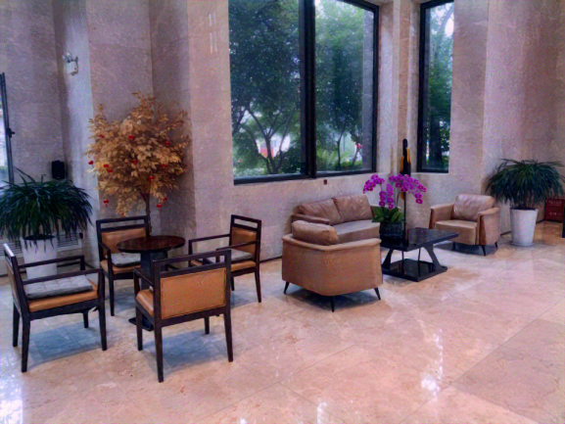
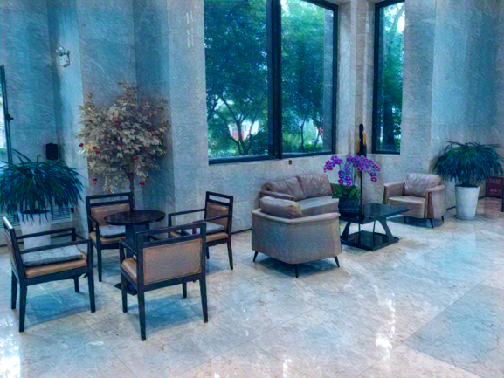
Filters

Slide 11
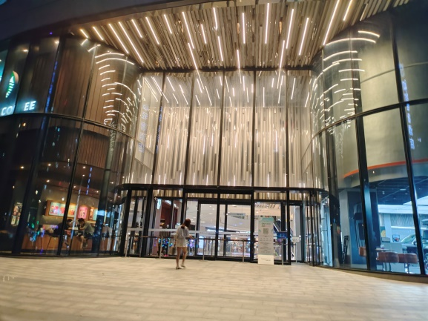
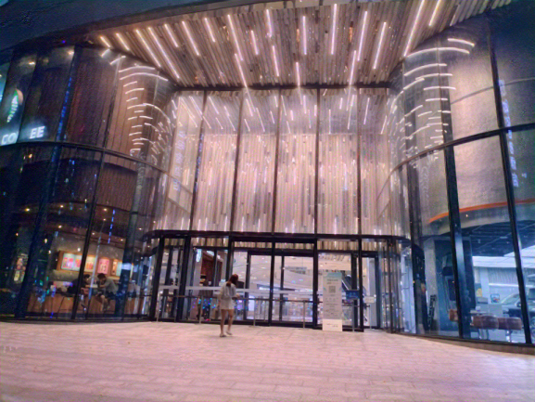
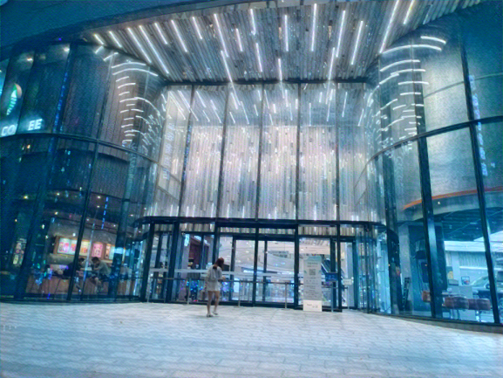
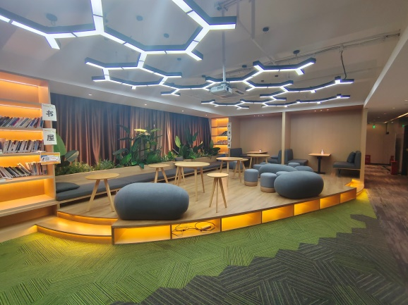
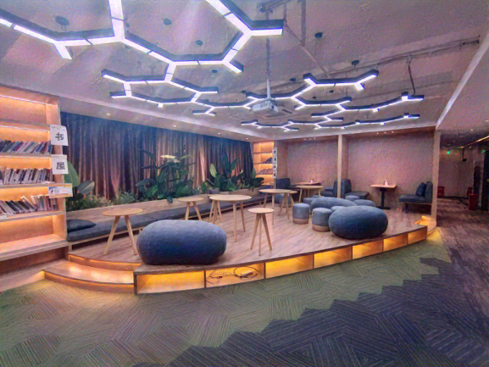
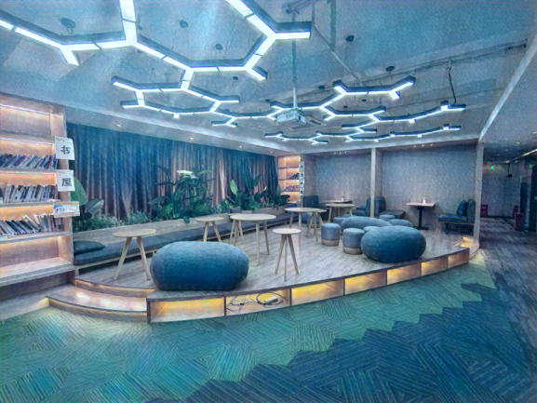
Filters

Slide 12
Art Style
Regarding image processing, the first thing that comes to our mind is the filters, which are mostly in the camera function option of our mobile phones.
Here we propose a solution to transform your painting style into Georges Braque, Maurits Cornelis Escher, Pablo Picasso, Salvador Dalíand. Therefore, AI makes art last forever.

Slide 13
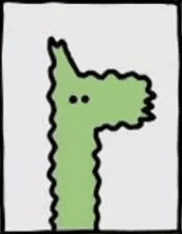
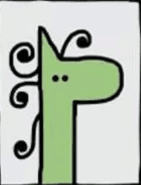





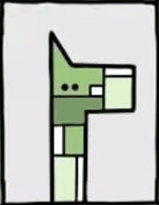
Art Style

Slide 14
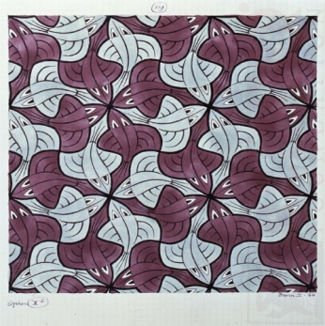
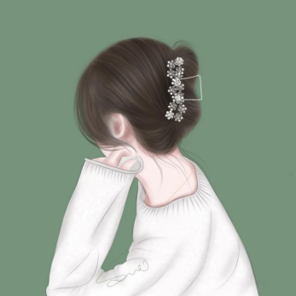
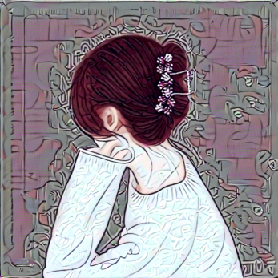
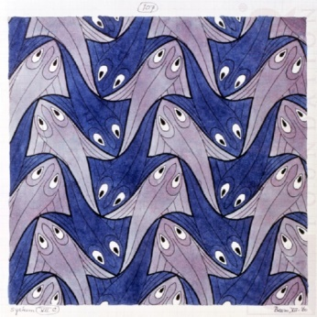
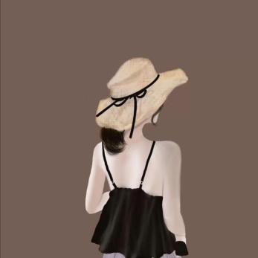
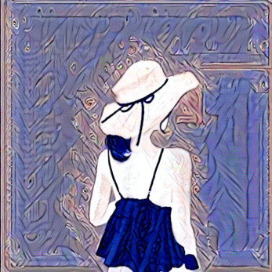
Portrait2Painting

Slide 15
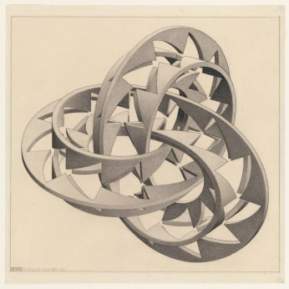

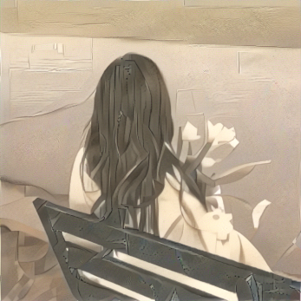
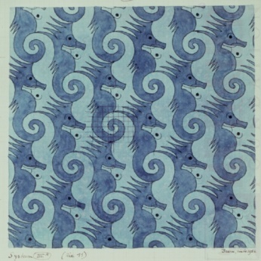
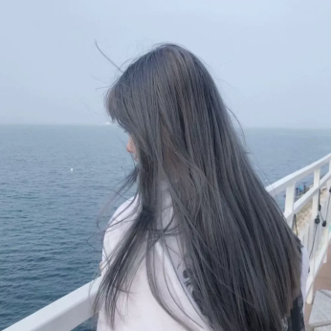
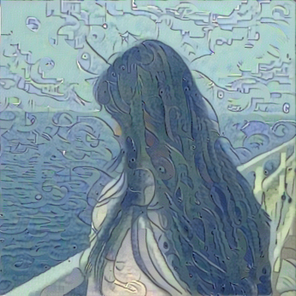
Portrait2Painting

Slide 16
Living Room Design
Use a text recognition algorithm to convert the floor plan into a json file
Import the json file into Unreal Engine 5
Visualize the JSON file by creating a 3D scene of the room

Slide 17
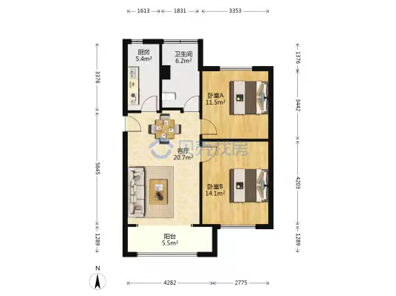
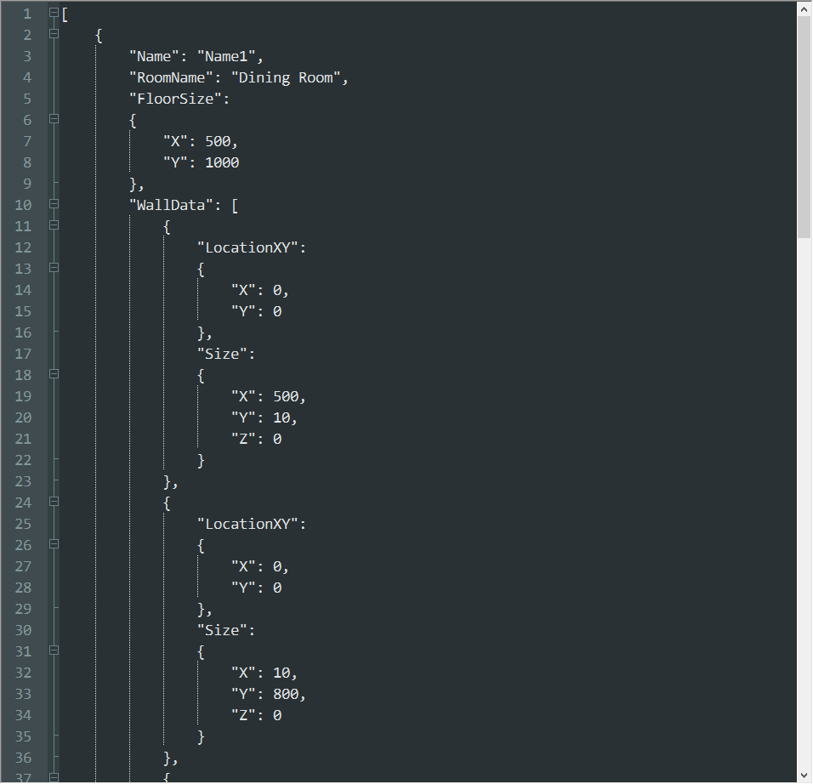
Text Recognition

Slide 18
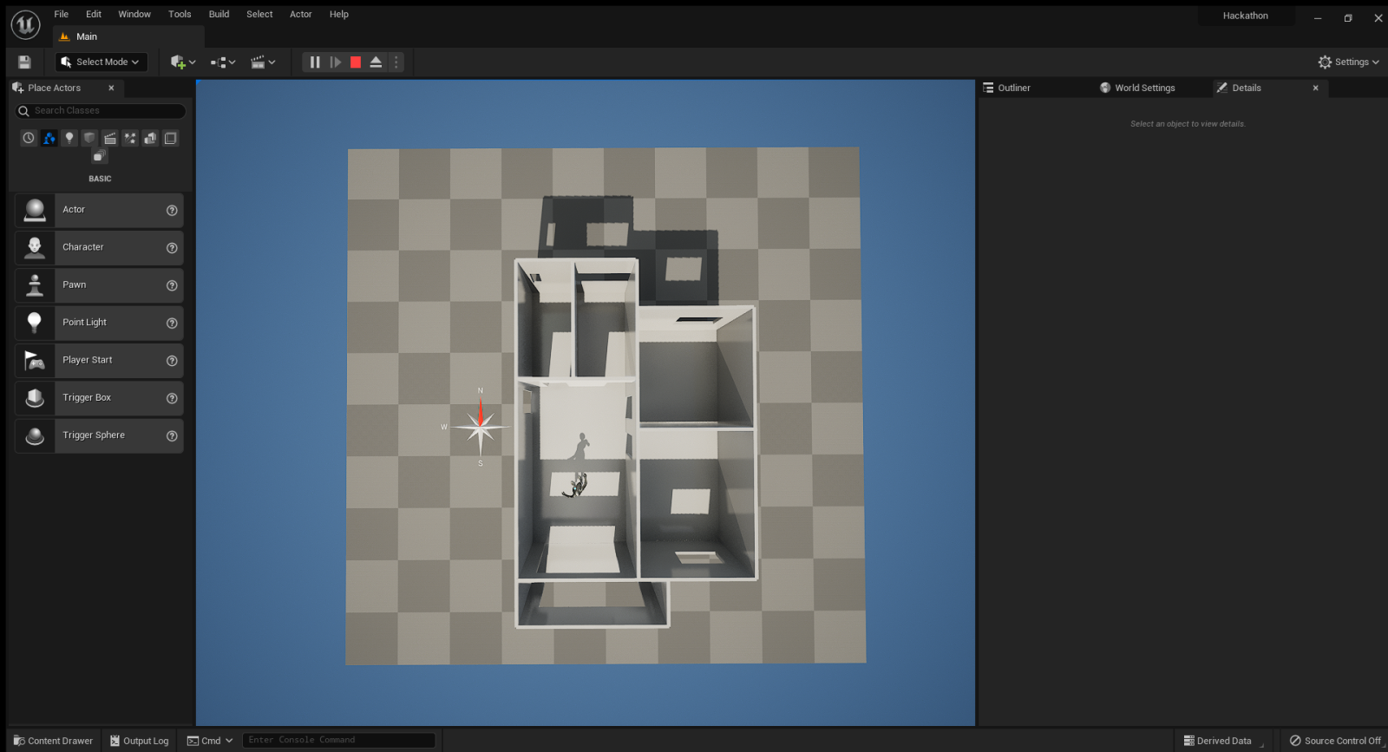
Living Room Design

Slide 19
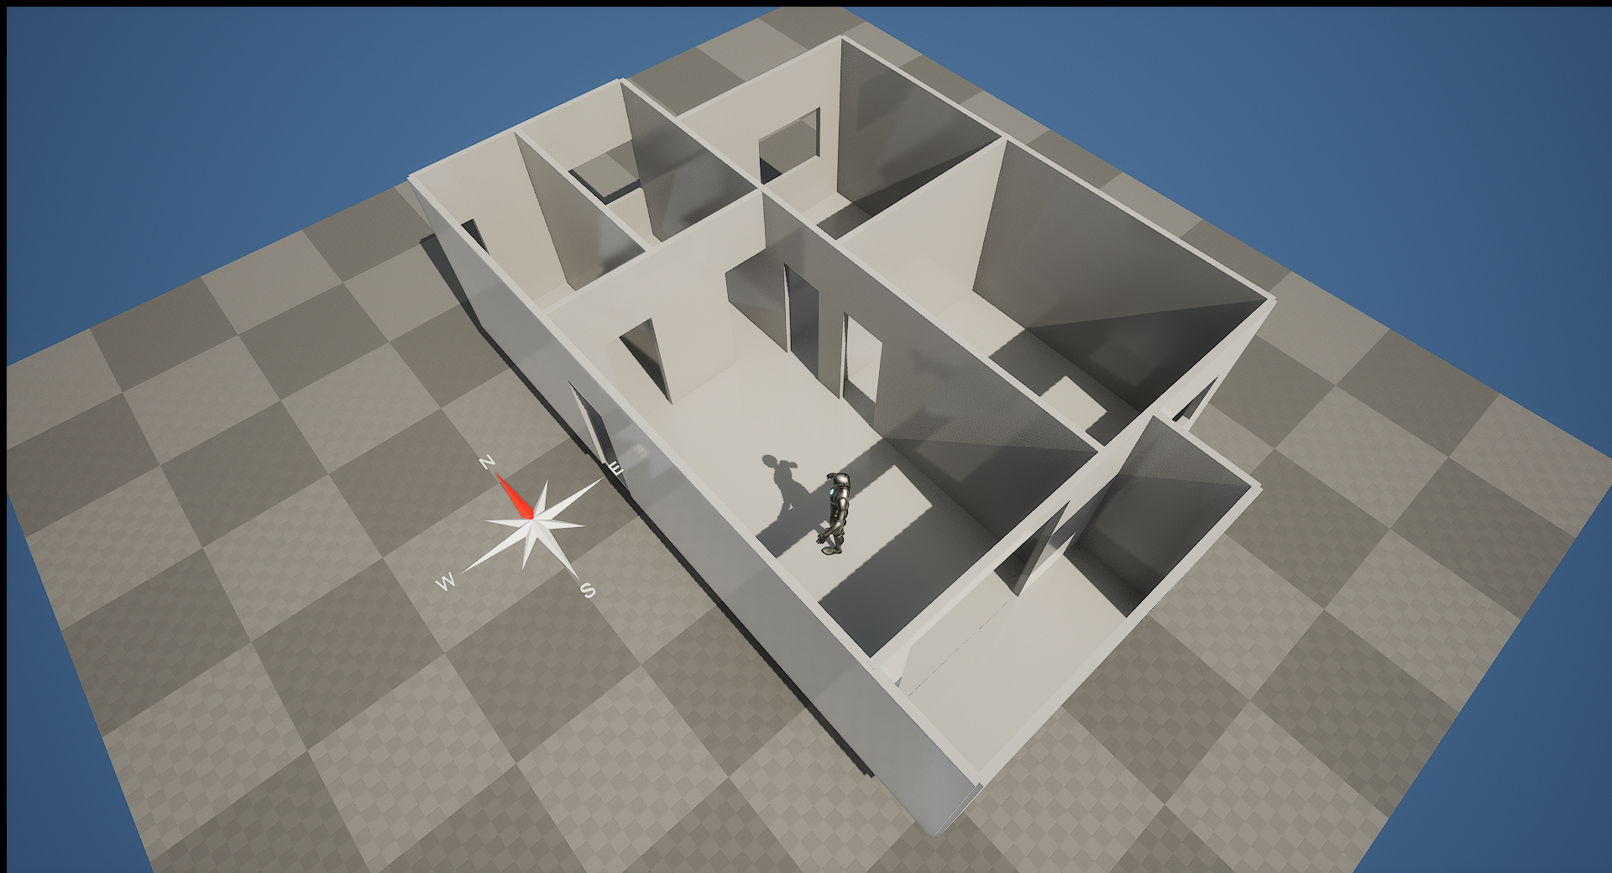
Side View

Slide 20
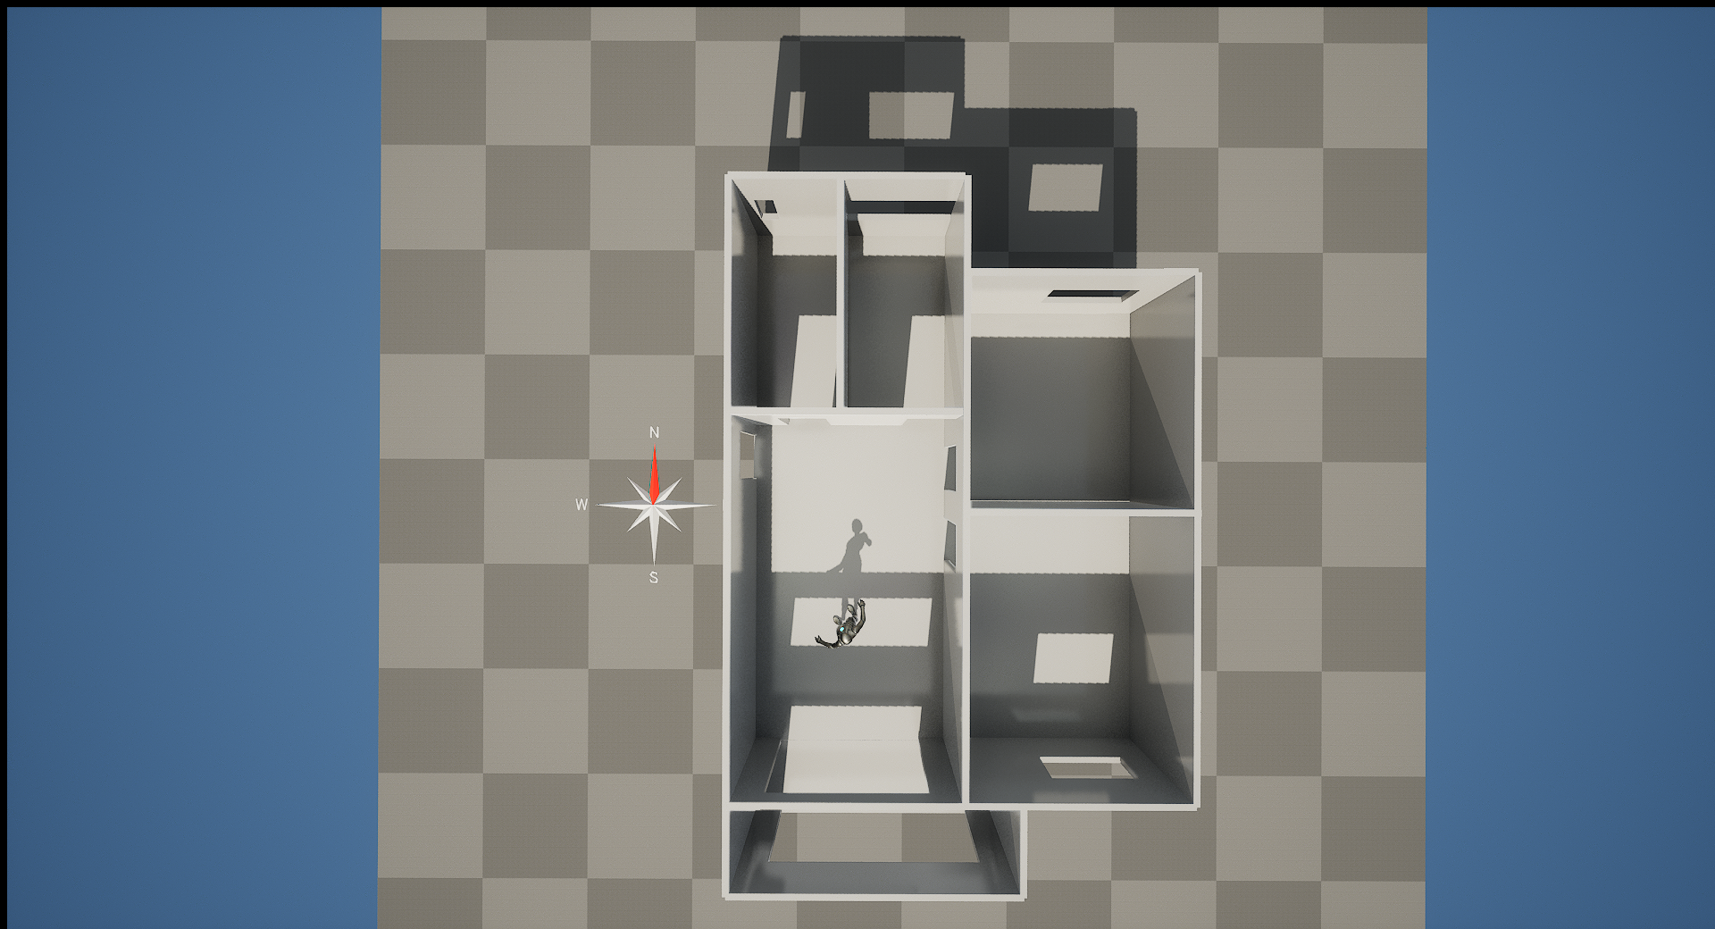
Top View

Slide 21
Living Room Design
Remember Style Transfer I mentioned earlier? We can turn it into a mural and hang it on the wall. So we can create custom style Metaverse.

Slide 22
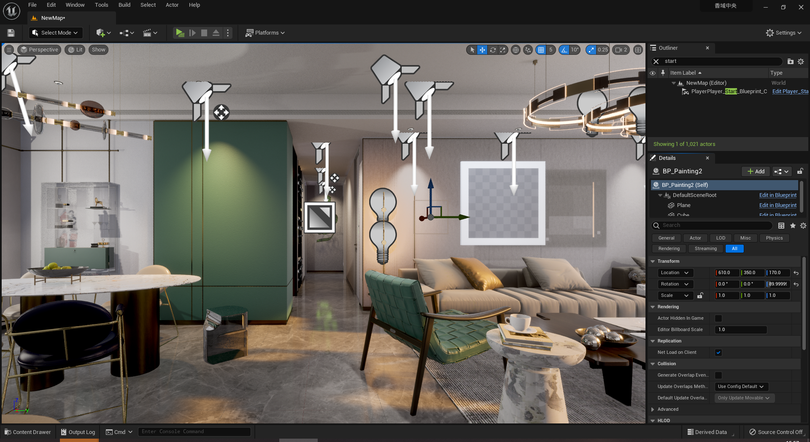

Slide 23
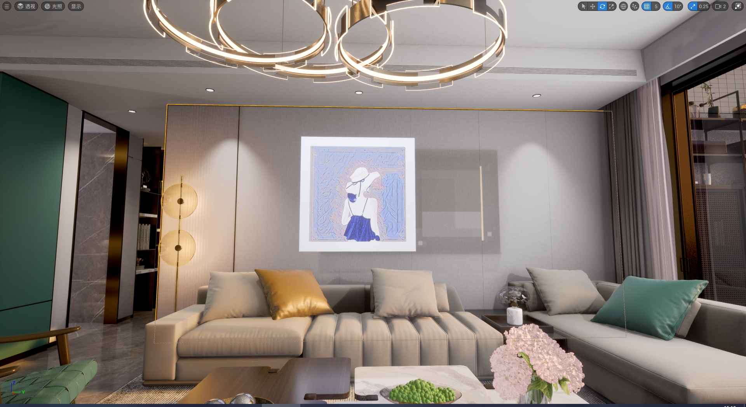

Slide 24
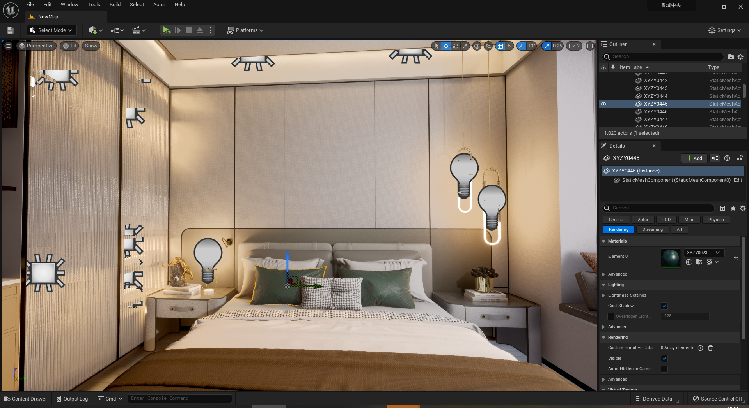

Slide 25
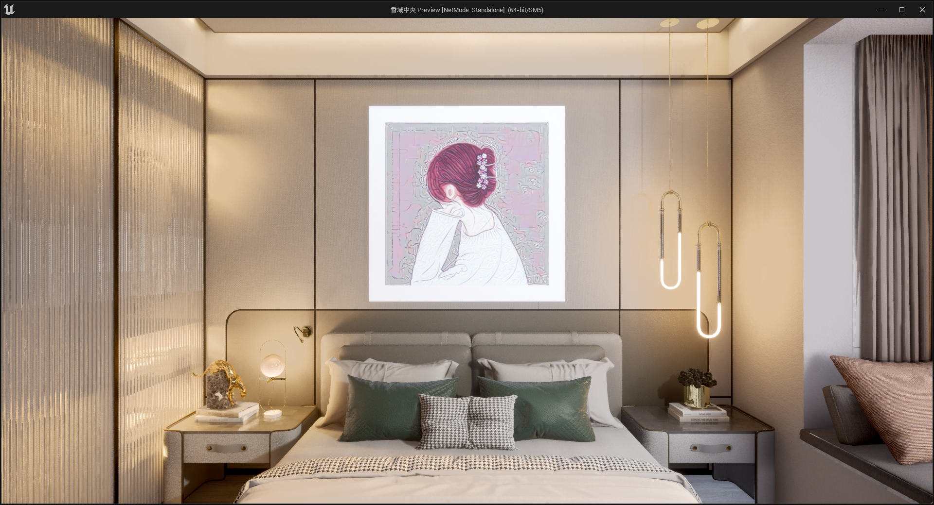

Slide 26
Conclusion
Copyright protection for the interior design industry
Copyright owners can recreate via smart contracts
Everyone can participate in the creator platform
Artificial intelligence enables more convenient content generation

Slide 27

THANK YOU

